Slide 1

COMBINATORICS: COUNTING PRINCIPLES

Slide 2
COUNTING PRINCIPLES
Addition Rule
E.g.: I can go to college by bus, metro, one of my brothers car, or on foot.
1+1+2+1 = 5 ways to go to college
Multiplication Rule
E.g.: 2 ties, 5 jackets, 4 jeans, 2 shoes
2 x 5 x 4 x 2 = 80 dressing styles .

Slide 3
Double counting!!
Addition Rule
Subtract!
Multiplication Rule
Divide!

Slide 4
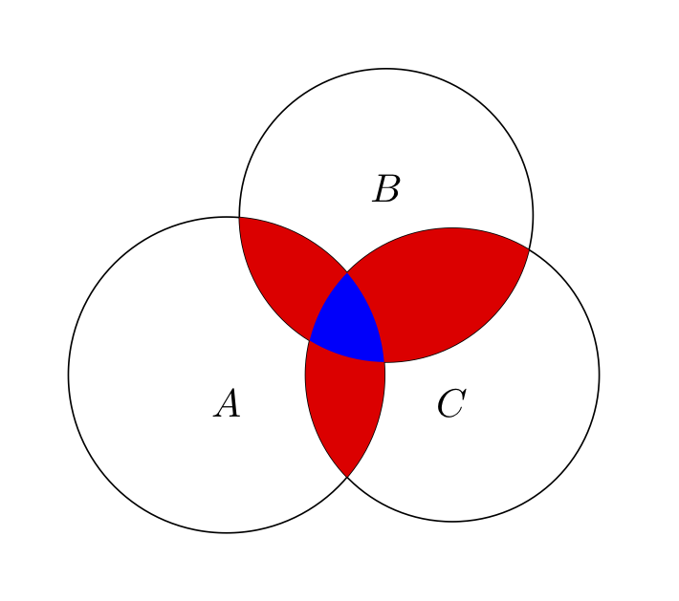
Inclusion-Exclusion principle
Venn Diagram

Slide 5
PRACTICE
Problem: Problem - K - Codeforces
Solution: Submission #248283445 - Codeforces

Slide 6
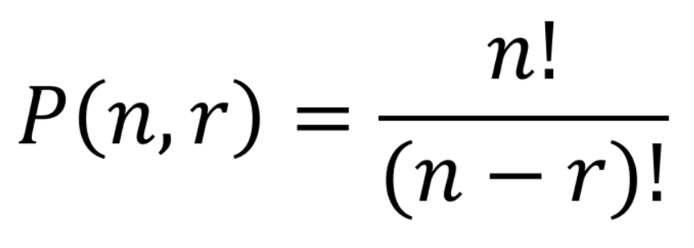
PERMUTATIONS
Order matters and repetition doesn’t matter
Ex1: Passwords of size 3 using 5 letters (a-b-c-d-e):
5P3=60
1

Slide 7
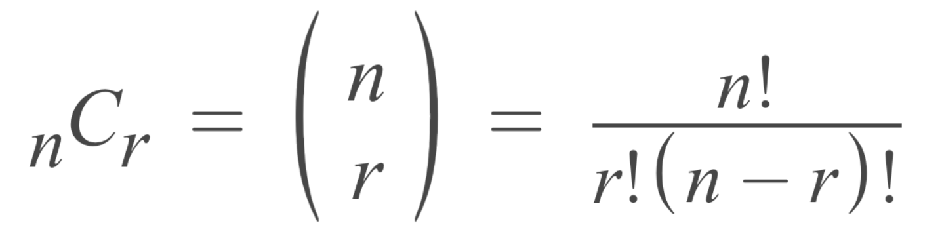
COMBINATIONS
Order doesn’t matter, repetitions doesn’t matter
Ex1: a competition of 5 engineers. You want to choose a team of 3 boys out of 7 and 2 girls out of 4
= 7C3*4C2
Ex2: We have a group of 8 friends, and we want to form a team of 4 people to participate in a game. However, 2 of our friends, Alice and Bob, refuse to be on the same team.
= 6c4 + 6c3 + 6c3 ((noA,noB) or (yesA, noB) or (noA, yesB)) → sol
= 8c4 – 6c2 (reverse thinking)

Slide 8
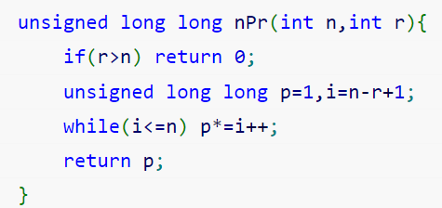
PERMUTATION LINEAR CODE

Slide 9
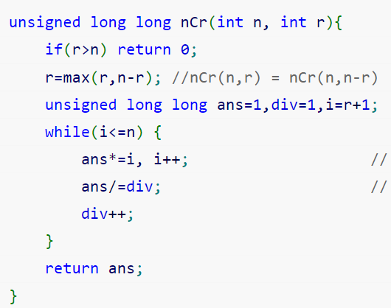
COMBINATION LINEAR CODE
Optimized solution?

Slide 10
PRACTICE
Problem: Problem - A - Codeforces
Solution:Submission #248287812 – Codeforces

Slide 11

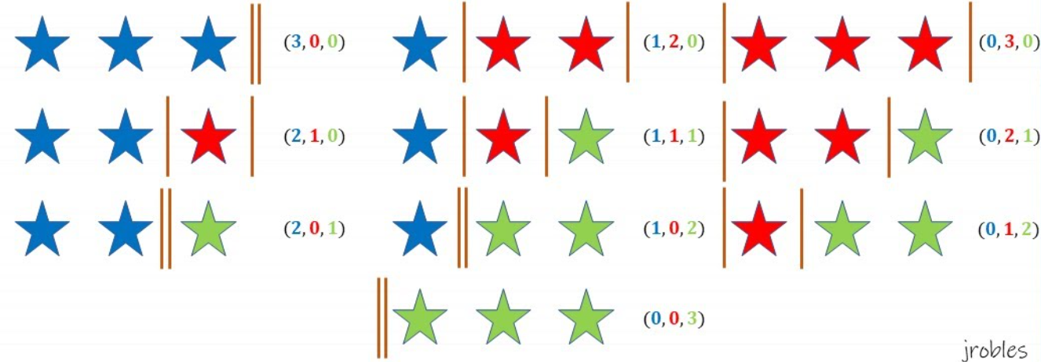
Stars and Bars
n is number of identical objects, and k is number of groups.
Eg: 3 groups and 3 objects, how many ways to distribute them?
Notes:
K-1 as we need to separate between the k groups by k-1 bars.
Then total number of objects are (n+k-1) => factorial to get number of ways of distribution.
We then divide by factorial(n) (stars) and factorial (k-1) (bars) to remove repetitions

